Slide 1
Graphics Display Devices
Lecture 2

Slide 2
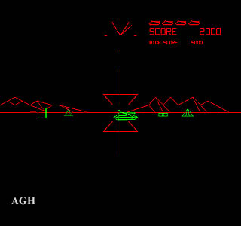
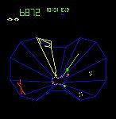
Vector Displays
Early computer displays: basically an oscilloscope
Control X,Y with vertical/horizontal plate voltage
Intensity or brightness of the display is sometimes called the Z axis.
Notes:
An oscilloscope is a laboratory instrument commonly used to display and analyze thewaveform of electronic signals.
In effect, the device draws a graph of the instantaneous signal voltage as a function of time.
Oscilloscope is electronic test equipment that allows to signal voltages to be viewed usually as a 2D graph.

Slide 3
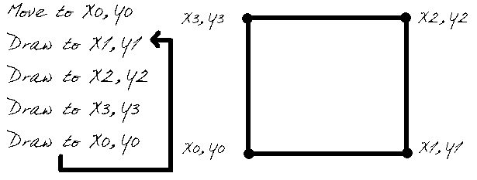
Vector Drawing’s Commands

Slide 4
Each line segment to be displayed takes very few data values
Vector displays can draw a picture very rapidly
Each XY pair is used to generate deflection voltages
which will sweep the beam across the face of screen
When the beam strike the phosphor,
visible light is produced for certain time
Notes:
Deflection voltages i.e bend voltages,, that are reflected

Slide 5
Vector Displays Disadvantages
Complex object drawing is difficult
list of commands becomes very long
Complex scenes
visible flicker
first line may have faded out before last is drawn
Vector displays can not show
smoothly shaded regions
Scanned images
Cross hatching effect
Notes:
Flicker: light that vary rapidly in brightness

Slide 6
Raster Displays
Raster: A rectangular array of points or dots
Pixel: One dot or picture element of the raster
Scan line: A row of pixels

Slide 7
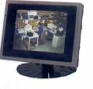
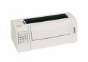
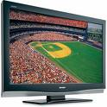
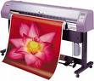
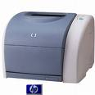
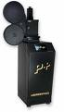
Raster Displays Contd…
Dot matrix
Ink jet plotter
Film recorder
Video Monitor
Flat panel
Laser printer

Slide 8

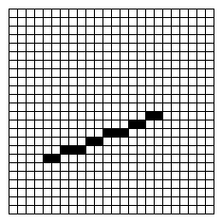
Raster Displays Contd…
Line/vector display raster display
no pixels array of pixels

Slide 9
Display Technologies
CRT
DVST
Calligraphic or Random Scanned Display Systems

Slide 10
Cathode Ray Tubes (CRTs)
Most common display device today
Evacuated glass bottle
Electrons pulled towards anode focusing cylinder
Vertical and horizontal deflection plates
Beam strikes phosphor coating on front of tube

Slide 11
CRT
It converts electrical signals to visual signals. It has specialized evacuated tube in which image is produced when an electron beam strikes a surface.
Components:
1. Electron gun ( heated filament, cathode and anode)
electron beams , electrons emitted by the cathode are accelerated by the anode.
2 Deflecting system:
X plate and y plate deflecting. X horizontal deflection and y cause vertical deflection
3 Florescence screen :
- glows when the beam of electron hits it,
Notes:
Cathode: the negatively charged electrode by which electrons enter an electrical device.
Anode: the positively charged electrode by which the electrons leave an electrical device.

Slide 12
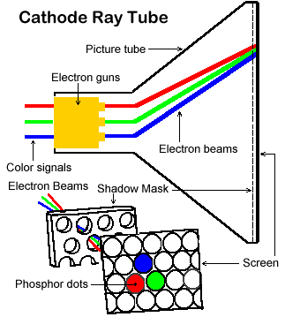
Notes:
a perforated metal sheet that ensures that the electron beam hits only the correctly colored phosphor dots and does not illuminate more than one dot.
. The shadow mask absorbs electrons that are directed at the wrong color phosphor.

Slide 13
Phosphers
Flourescence:
Light emitted while the phospher is being struck by electrons
Phospherescence:
Light emitted once the electron beam is removed
emits visible light for a certain period after the bombardment has ceased
Persistence:
Time from the removal of the excitation to the moment when phosphorescence has decayed to 10% of the initial light output
Long persistence -> image smears as picture is moved on screen.
Short persistence -> no smearing as image moves but more refreshing needed
Notes:
Mark , dirty , damage
persistence is the time to which the phosphors in the CRT emit light until the next electrons is fired.

Slide 14
CRT Display Devices
A few examples of Computer Graphics devices are:
CRT(Cathode Ray Tube)
EGA (Enhanced Graphics Adapter
CGA (Color Graphics Adapter
VGA(Video Graphics Adapter
SVGA(Super Video Graphics Adapter
Monitors
Plotters
Data Matrix
Laser printers
Films
Flat panel devices
Video digitizer
Scanners
LCD Panels
Keyboard
Joystick,
Mouse,

Slide 15
CRT
CRT monitor is most commonly used device
Types of CRT monitors:
1. DVST(Direct View Storage Tube)
2. Calligraphic or Random scan Display system
3. Refresh and Raster Scan Display System.
The common feature in all these three display devices is the cathode ray tube.

Slide 16
DVST
Long persistent Phosphor.
Doesn’t need to refresh
Provides flicker free display
A slow moving electron stream draws a line on the screen.
The screen has a storage mesh in which the phosphor is embedded.
Image is stored as a distribution of charges on the inside surface of the screen.
It has very limited interactive support.

Slide 17
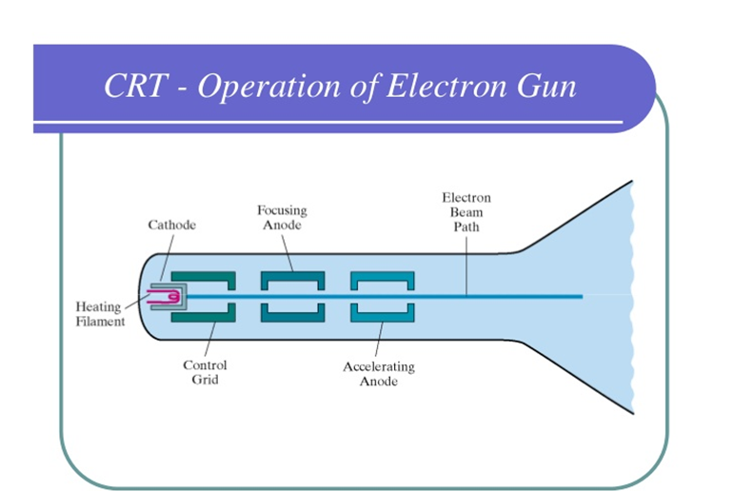

Slide 18
Calligraphic or Random Scanned Display Systems
Vector stroke or line drawing display because the electron beam is deflected from one point to another
Those sequence of commands that guide the beam to move from one point to another in order to create short strokes or lines

Slide 19
Raster displays
Fixed scan pattern
left to right, top to bottom
To paint the screen, computer needs to synchronize with the scanning pattern
Framebuffer
special memory to buffer image with scan-out synchronous to the raster display device.
Region of memory should be large enough to hold all pixel values
Graphic card
House the memory require for frame buffer
Notes:
Graphic card: The graphics components that control and enhance how graphics (pictures, videos, programs, animation, 3D) are displayed on your screen.
Frame buffer:
Contains color value of every pixel.
large, contiguous piece of computer memory.

Slide 20
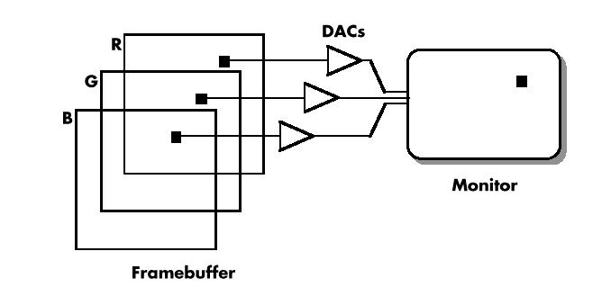
Scanning process
RGB Frame buffer
Notes:
Dac is used to produce primary colors, which converts digital or logic values 01 into voltages.

Slide 21
Index Colour and lookup table
Each pixel go through an intermediate step
Before they drive CRT
These bits are used as an index in to a table of 2^{n} values

Slide 22
Color is expensive …
The more color you want, the more bits you will need for each pixel
Exercise: 1024 x 1280 screen with
24 bits per pixel, how large is the frame buffer?
1024 x 1280 x 24 / 8 = 4M Byte

Slide 23
Efficient Mapping: LUTs efficiently map input values to output values, facilitating tasks like color correction and grading.
Color Correction and Grading: They are commonly used for color correction and grading to achieve desired looks or correct color inaccuracies.
Real-time Rendering: In real-time graphics, LUTs help achieve effects like color grading without significant computational overhead.
Non-linear Effects: LUTs are useful for applying non-linear effects such as gamma correction or tone mapping efficiently.
HDR Imaging: They play a role in HDR imaging by implementing tone mapping operators effectively for displaying high dynamic range images on standard displays.

Slide 24
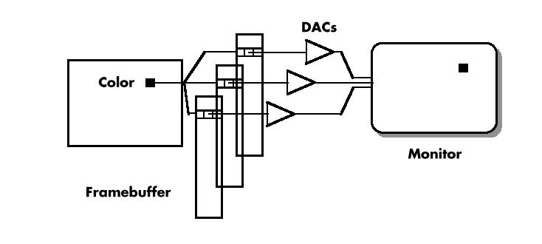
Colour Index Framebuffer

Slide 25
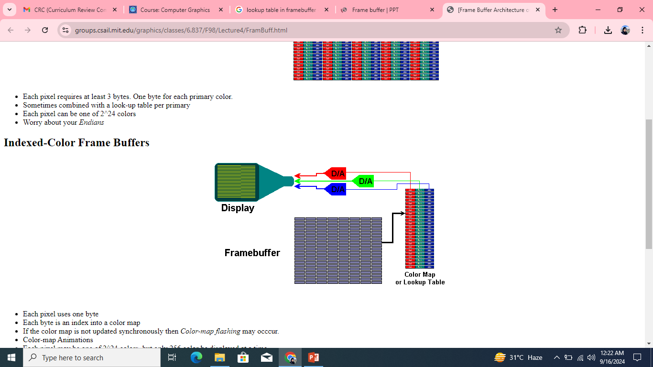
Each pixel uses one byte Each byte is an index into a color map If the color map is not updated synchronously then Color-map flashing may occcur. Color-map Animations Each pixel may be one of 2^24 colors, but only 256 color be displayed at a time

Slide 26
Without lookup table
Frame buffer memory = 4MB
24 bits per pixel
With lookup table
Frame buffer memory = 1 MB
8 bits per pixel

Slide 27
Color Lookup Table
only 3 bits per pixel
But one insist on having high quality pictures …
Use Color Look Up Table (LUT)
R G B
0
1
2
3
4
5
6
7
You can still have 24 bits
in each of the color table
entries
24 bit wide
3 bits/pixel frame buffer

Slide 28
LUT memory
If Raster display has color depth= b bits
Each LUT entry is w bits wide then
System can display
2^{w} colors 2^{b} at one time
So it require very little memory
Only 2^{b} words of w bits each
System have capability of 24 bit colors
Frame Buffer
1024 x 1280 x 8 / 8 = 1M Byte
LUT
768 bytes (2^{b} *w/8 )
Notes:
B never exceeds w.
B=8
w=24
(2^8 * 24)/8

Slide 29
Summarizing LUT
System has color depth of b bits.
LUT entry is w bit wide
System will display: 2^{w} colors 2^{b} at one time
Relationship b/w bitplanes and width of LUT
W is multiple of 3 derive each DAC.
Memory required by LUT
2^{b} *w/8
Storage required by System
b/3*rows *cols + size of LUT
Notes:
3 bits will have 8 values

Slide 30
Size of frame buffer:
rows *col * bits per pixel/ 8
Memory required by LUT
2^{b} *w/8
Storage required by System
b/3*rows *cols + size of LUT
Notes:
3 bits will have 8 values

Slide 31
Task 1
A system with b=8 bits and LUT width w=12 can display _____________ colors , and ___________ colors at 1 time?
A system with b=8 bits and LUT width w=24 can display ____________ colors , and ___________ colors at 1 time?
A system with b=12 bits and LUT width w=18 can display _____________ colors , and ___________ colors at 1 time?
Notes:
Solution 1: 4096 total and 256 1 time
Solution 2: 16777,216 total and 256 1 time
Solution 3: 256 K 262144 colors and 4096 at a time.

Slide 32
Exercise:
640 × 480 screen with 12 bits per pixel, how large is the frame buffer?
1280 x 1024 screen with 12 bits per pixel, how large is the frame buffer?
2560 × 2048 screen with 12 bits per pixel, how large is the frame buffer?

Slide 33
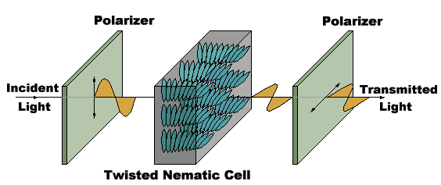
Display Technology: LCDs
Liquid Crystal Displays (LCDs)
organic molecules
naturally in crystalline state
that liquefy when excited by heat or E field
Crystalline state twists polarized light 90º.
Notes:
It converts electric field into visible dots on the screen .
Electric field causes the polarization of crystals.
LCD is composed of several layers which include two polarized panel filters and electrodes. Light is projected from a lens on a layer of liquid crystal. (formed as electric current flows through the crystal) forms the colored image. This image is then displayed on the screen.
to cause light waves to vibrate in a particular pattern
TN: twist and untwist at varying degrees to allow light to pass through

Slide 34
Display Technology: LCDs
Converts electric field to visible dots
Each pixel is addressed by horizontal and vertical grid wire
Notes:
Each pixel is displayed on the fixed grid or on the fixed predefined sequence. Frame
Predefined frame or mold on which each point will be displayed.

Slide 35
Active matrix panels
Are LCD panels
Have tiny transistors at each pixel
Transistors responds to electric field
adjusts the liquid crystal by an amount proportional to the field
Allow the display of different level of brightness
Transistors provide some “memory”
that holds the crystals in their adjusted states
so that the display need not be refreshed
This produce much brighter display
Notes:
Tiny transistor is present on each pixel location . transistor have some memory that will allow to save the crystal state. So display needed not to be refreshed.

Slide 36
Display Technology
Plasma
Display geometry
Neon bulb turn on and off by electric field
DMD / DLP
optical semiconductor, called a Digital Micromirror Device (DMD),
uses mirrors made of aluminum to reflect light to make the picture
Organic LED Arrays
It consists of a series of organic layers between two electrical contacts (electrodes).
Each layer is deposited on the other, creating a single unit.
Notes:
Geometry means vertical grid and horizontal grid. So the plasma need not to be refreshed.
DMD; : resolution , brightness, contrast.
LED : light emitting diode (elecrodes)

Slide 37
Hard Copy Raster Devices
Film Recorder
Strip of photographic film
electron beam exposes as it sweeps over it in raster pattern
Electronic Hard copy of Image
Laser Printer
Sweep a laser beam on internal defined buffer
Surface becomes electronically charged causing toner to follow spots.
Notes:
Hard copy raster devices are used when you want the permanent version of the image usually on the paper. Devices draw the pictures by transferring the information from the buffer to the display medium.
Toner is then transferred into the paper, to create the image,
Film recorder Have their own frame buffer or camera mounted on CRT

Slide 38
InkJet Plotter
A tiny nozzle sweeps over the paper and squirts (sprays) proper color of ink at each pixel position.
Post Script Language
Printer are equipped with micro processor.
Generate high quality text and graphics
Notes:
Post script language can generate the high quality text and graphics on the printed page.

Slide 39
SIZE OF FRAME BUFFER
(X-Resolution * Y-Resolution * Bits-Per-Pixel) / (8)
Example 1:
640 × 480 × 12 bits ÷ 8 bits per byte = 450 B in order to convert into KB, divide the result by 1024
Notes:
1 MB = 1024 KB
(X-Resolution * Y-Resolution * Bits-Per-Pixel) / (8 * 1,048,576)
640 × 480 × 12 bits ÷ 8 bits per byte = 450 B in order to convert into KB, divide the result by 1024 1280 × 1024 × 12 bits ÷ 8 bits per byte = 1920 B 2560 × 2048 × 12 bits ÷ 8 bits per byte = 7680 B For 24 bits of storage per pixel, each of the above values is doubled.

Slide 40
EXAMPLE 2
1280 × 1024 × 12 bits ÷ 8 bits per byte = 1920 B 2560 × 2048 × 12 bits ÷ 8 bits per byte = 7680 B For 24 bits of storage per pixel, each of the above values is doubled.

Slide 41
References
Computer Graphics using open GL( chapter 1) by F.S Hill
InterNET Resources
Howstufff works.com/lcd.htm
& A lot More

